Slide 1
Referrals and Orders
How to ask for stuff in FHIR
Lloyd McKenzie
Dec 4-5, 2023

Slide 2

Who am I?
Name: Lloyd McKenzie
Company: Dogwood Health Consulting
Background:
One of FHIR’s 3 initial editors
Co-chair FHIR Management Group and FHIR-Infrastructure
HL7 Fellow
Lead for FHIR Infrastructure’s “Workflow” project
lloyd@dogwoodhealthconsulting.com

Slide 3
Who are you?
What will make this training most valuable to you?

Slide 4
This presentation
Can be downloaded here:
https://github.com/FHIR/documents/tree/master/presentations/2023-12%20Tutorials
Is licensed for use under the Creative Commons, specifically:
Creative Commons Attribution 3.0 Unported License
(Do with it as you wish, so long as you give credit

Slide 5
Objectives
Understand workflow resource patterns
Differentiate ‘Request’ and ‘Task’ resources
Alternatives for ‘grouping’ Request resources
Choose appropriate mechanism to seek fulfillment
Know when Task alone can suffice
Explore your workflow questions

Slide 6
Workflow basics

Slide 7
Workflow is everywhere
Admit a patient
Order a lab
Ask patient to fill out a form
Dispense a drug
Execute a study protocol
Request a prior authorization
Schedule a home visit

Slide 8
EHR adoption
Workflow
Updateable
Write-once
Read-only

Slide 9
Workflow ‘patterns’
Definition
What can happen
(relatively) Independent of time and specific subject
Request
Plan/proposal/order for what should happen
Specific time and subject
Event
What did happen/is happening

Slide 10
Exercise: Which pattern?
ServiceRequest
PlanDefinition
Encounter
Claim
Questionnaire
VisionPrescription
ImmunizationRecommendation
RiskAssessment
Patient
Measure
Task
Composition

Slide 11
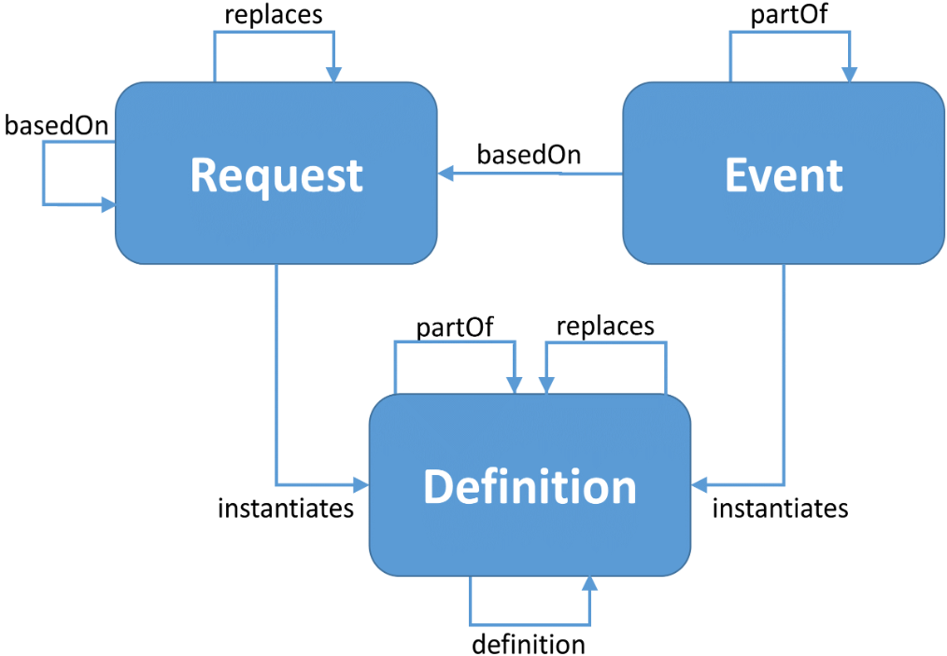
Workflow patterns
compliesWith
generatedFrom
shallComplyWith
triggeredBy
adheresTo
triggeredBy
shallComplyWith

Slide 12
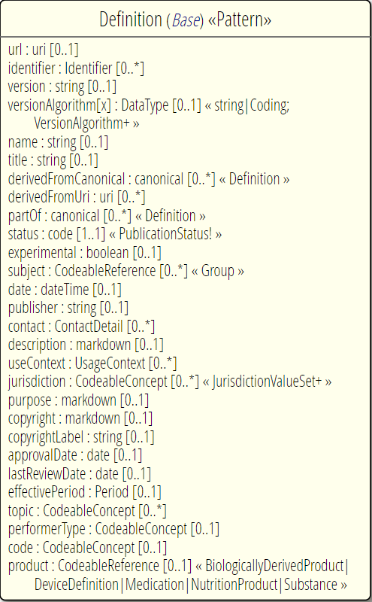
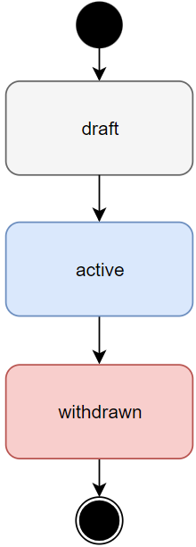
Definition Pattern

Slide 13
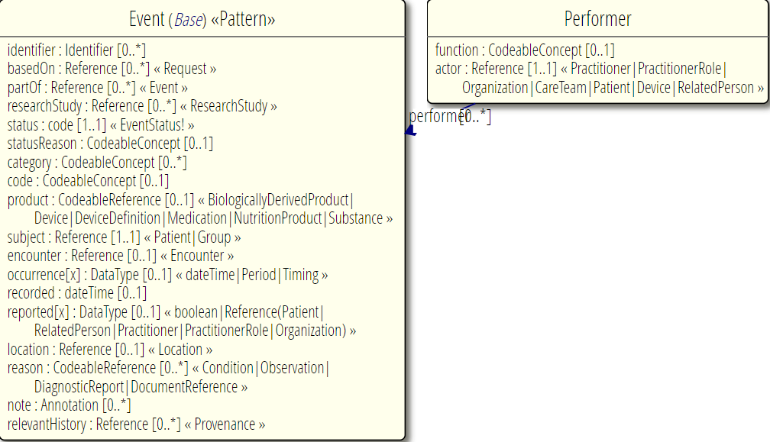
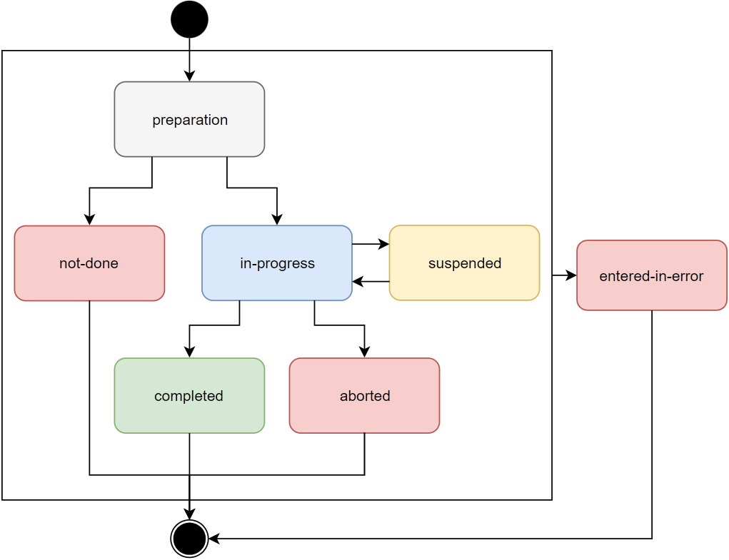
Event Pattern

Slide 14
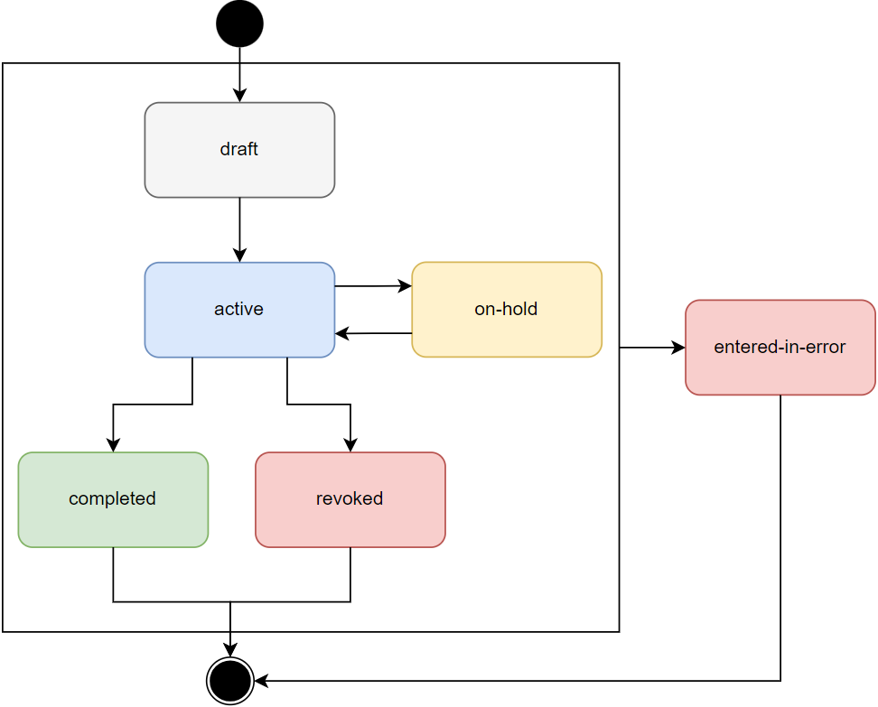
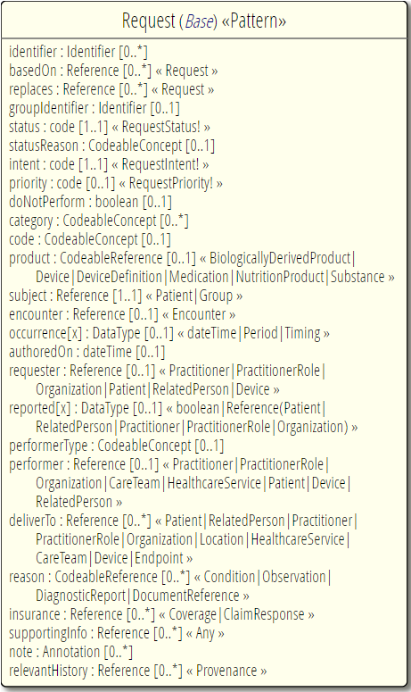
Request Pattern
Exercise 2: What’s missing?

Slide 15
Exploring Task

Slide 16
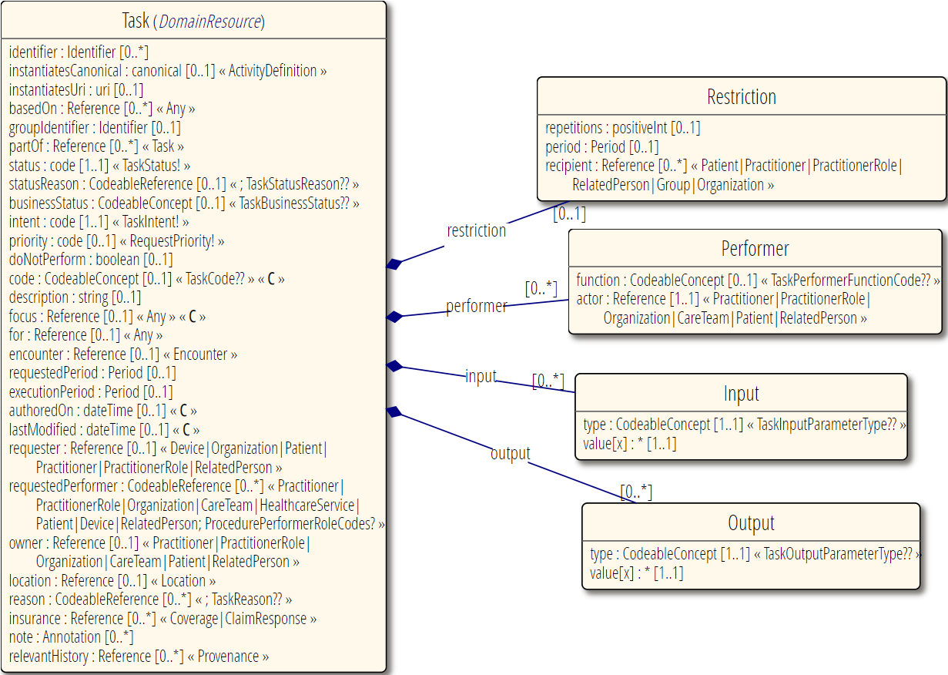
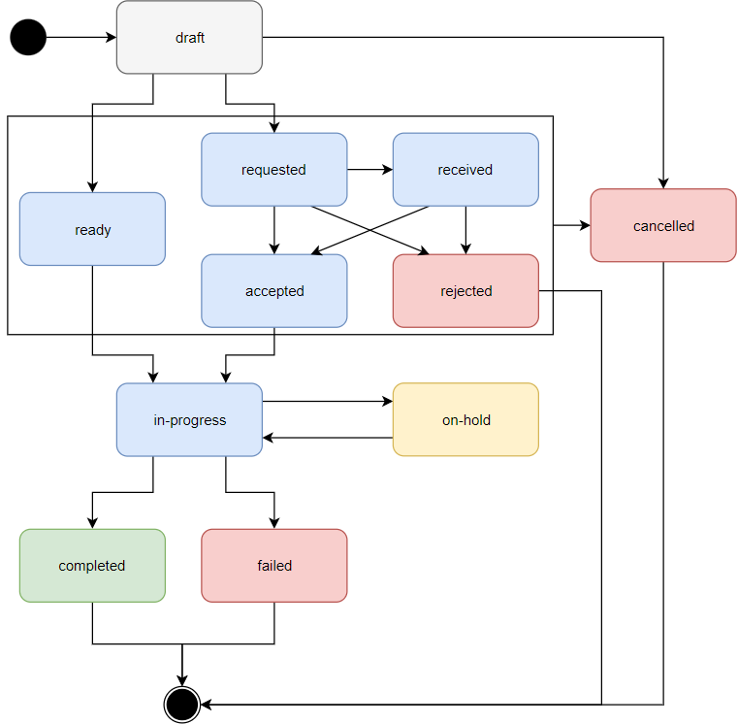
Task

Slide 17
Why Task?
What if performer is selected after order signed?
What if initial recipient says ‘no’?
What if you don’t want the whole order completed?
What if there’s extra information performer needs?
(not identified at order sign)
What if there’s communication that needs to happen during execution?
Task is only resource to be Request and Event

Slide 18
Seeking Fulfillment
Request
status=‘active’
Task
Organization
name=‘clinic1’
Task
status=requested
Task
status=rejected
focus
owner
basedOn
focus
Organization
name=‘clinic2’
Task
status=accepted
Task
status=requested
Task
status=failed
owner
focus
Task
status=accepted
Organization
name=‘clinic3’
Task
status=completed
Task
status=requested
owner
Notes:
Could still have more if Task was partial fulfillment (or filler not satisfied with result)

Slide 19
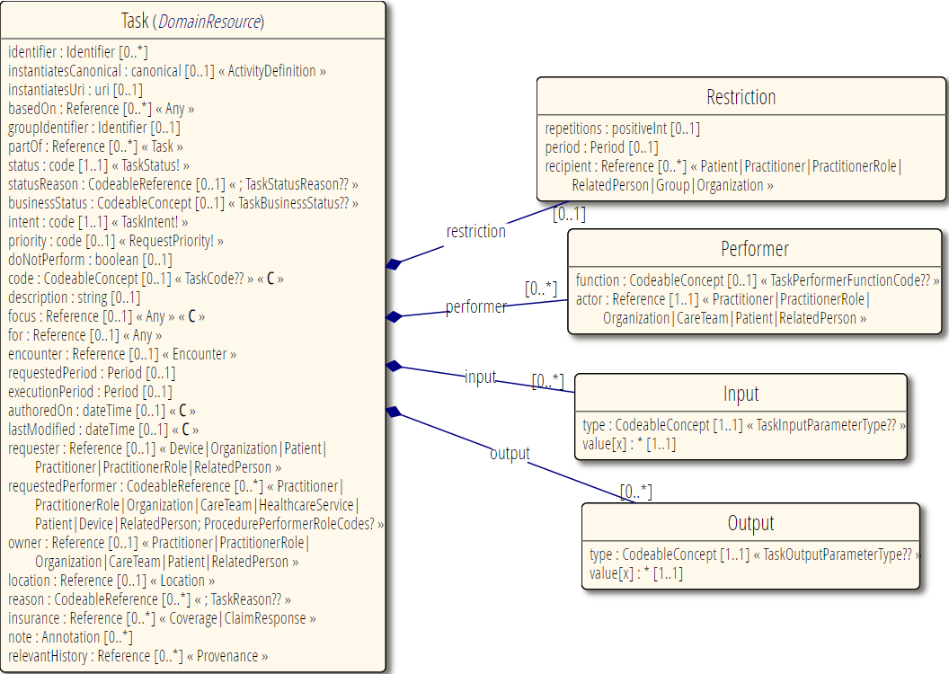
Task

Slide 20
Task Paths

Slide 21
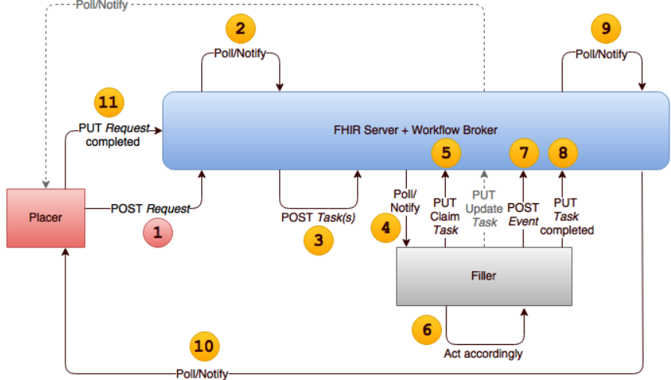
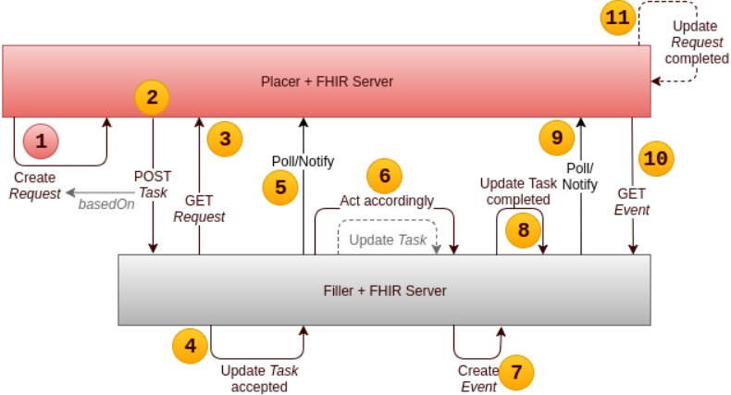
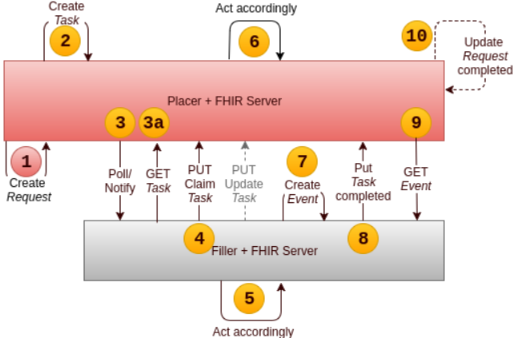
Task Location
Filler
Placer monitors
Placer
Filler monitors
Intermediary
Both monitor

Slide 22
Do you have to use Task?
Can just post the ServiceRequest to filler
Must have ‘actionable’ tag
Can also post to placer with assigned performer (polling/subscription)
Use messaging
Use a custom operation?
Use a document?

Slide 23
Do you have to have a Request resource?
NO:
Request a status change
Simple request that doesn’t require ‘authorization’
Change this bed
Review this report
Fill out this form

Slide 24
But I need to send more than just the Request…
Request.supportingInfo
Task.input
Query what you need
Composition to tell a story

Slide 25
Intent
proposal
basedOn
plan
basedOn
original-
order
basedOn
filler-
order
+ directive, reflex-order, etc.
basedOn
instance-
order

Slide 26
There are FHIR pages for this…
https://build.fhir.org/workflow-communications.html
https://build.fhir.org/workflow-ad-hoc.html
https://build.fhir.org/workflow-management.html
Also: https://chat.fhir.org/#narrow/stream/179196-workflow
Or come join our calls
Mondays, 2 Eastern
Details on FHIR-I Confluence page - https://confluence.hl7.org/display/FHIRI

Slide 27
Pros and Cons

Slide 28
Option B

Slide 29
Option C

Slide 30
Option F

Slide 31

Option H

Slide 32
What did you learn?
Order = authorization; Fulfillment = workflow process
Can seek fulfillment by
REST (variety of architectures), messaging, operation
FHIR offers more flexibility than “referral package”
Task is the one resource intended to be updated by ‘placer’ and ‘filler’
Workflow can tie resources together in complex chains
For guidance, look to Workflow in spec and chat.fhir.org

Slide 33




Questions / Discussion
lloyd@dogwoodhealthconsulting.com
Or, better yet, include the community and ask/discuss on chat.fhir.org

